Slide 1
0x105 – What are Embedded Systems?
ECED4406 – Computer Security
Dr. Colin O’Flynn
Dalhousie University.

Slide 2
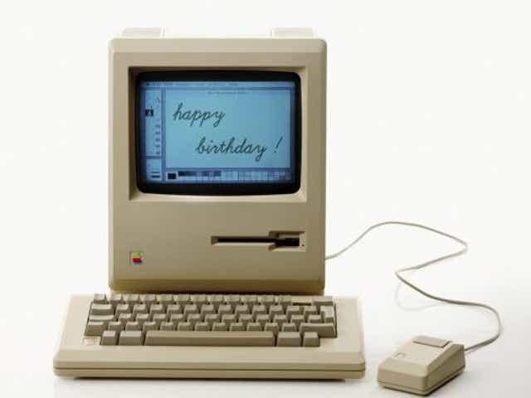
General Computers
Highly flexible & programmable.
Capable of running many applications.
Typically with some form of human or user interface.
Receives changes & updates during it’s lifetime.

Slide 3
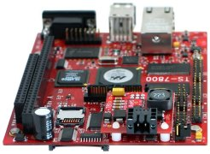
Embedded Computers
Typically specific purpose.
  Automotive control computer.
  Industrial robot controller.
  Consumer camera.
User interface?
Updates?

Slide 4
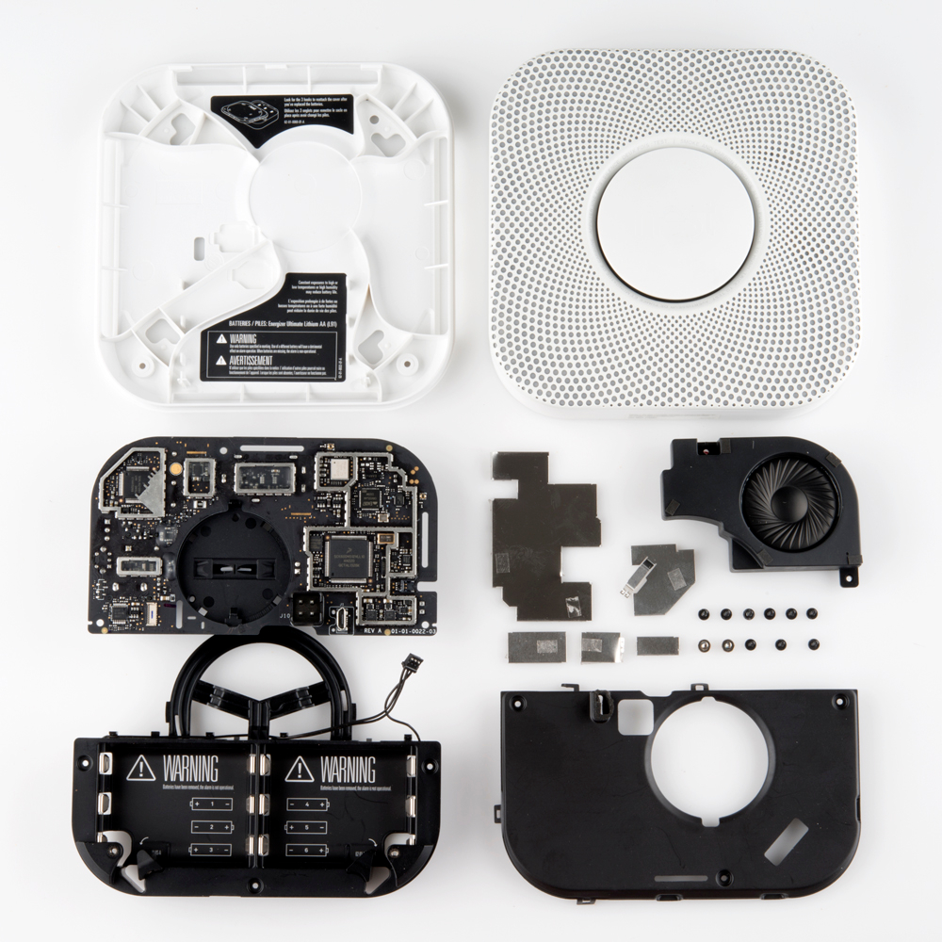
Restrictions on Embedded Computers
Embedded computers often have limits on:
  Memory.
  Cost.
  Size.
  Power

Slide 5
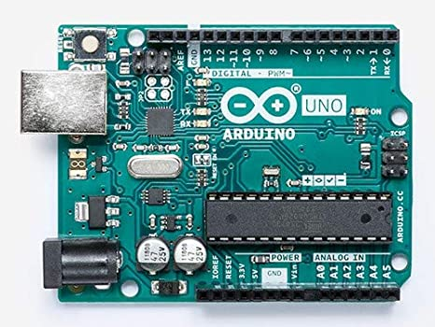
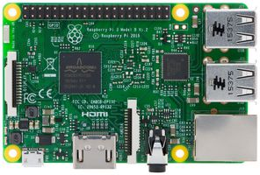
You’ve Already Used Embedded Computers!

